Slide 1
Viterbi Decoding for HMM, Parameter Learning
Pawan Goyal
CSE, IIT Kharagpur
Week 4, Lecture 1
POS Tagging
Week 4, Lecture 1

Slide 2
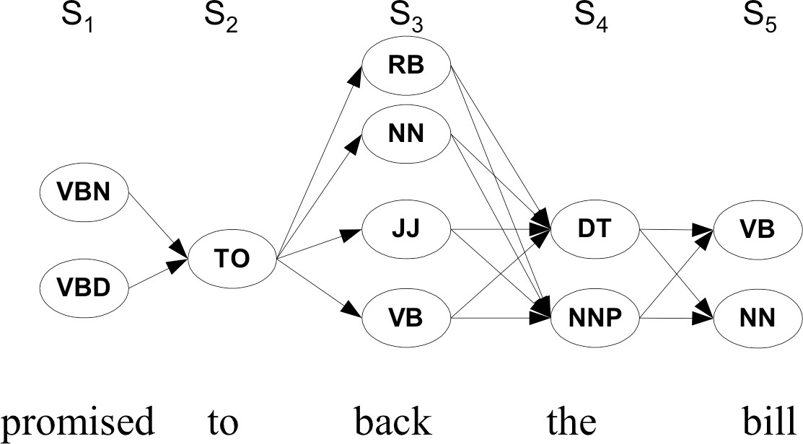
Walking through the states: best path
POS Tagging
Week 4, Lecture 1

Slide 3
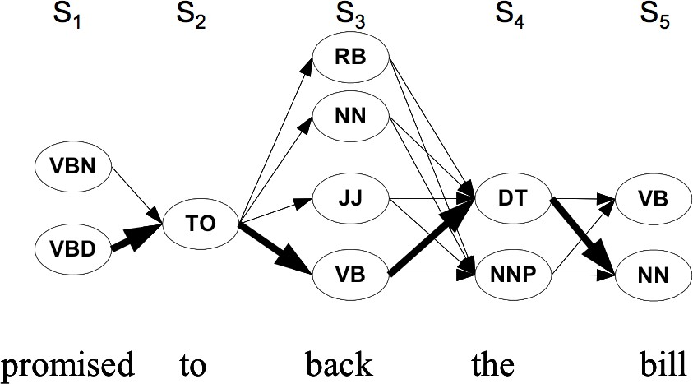
Walking through the states: best path
POS Tagging
Week 4, Lecture 1

Slide 4
Finding the best path: Viterbi Algorithm
Intuition
Optimal path for each state can be recorded. We need
Cheapest cost to state j at step s: δ_{j}(s)
Backtrace from that state to best predecessor ψ_{j}(s)
Computing these values
δ_{j}(s + 1) = max_{1≤i≤N} δ_{i}(s)p(t_{j}|t_{i})p(w_{s+1}|t_{j}) ψ_{j}(s + 1) = argmax_{1≤i≤N} δ_{i}(s)p(t_{j}|t_{i})p(w_{s+1}|t_{j})
Best final state is argmax_{1≤i≤N} δ_{i}(|S|), we can backtrack from there
POS Tagging
Week 4, Lecture 1
4 / 6

Slide 5
Practice Question
Suppose you want to use a HMM tagger to tag the phrase, “the light book”, where we have the following probabilities:
P(the|Det) = 0.3, P(the|Noun) = 0.1, P(light|Noun) = 0.003, P(light|Adj) = 0.002, P(light|Verb) = 0.06, P(book|Noun) = 0.003, P(book|Verb) = 0.01
P(Verb|Det) = 0.00001, P(Noun|Det) = 0.5, P(Adj|Det) = 0.3,
P(Noun|Noun) =0.2, P(Adj|Noun) = 0.002, P(Noun|Adj) = 0.2,
P(Noun|Verb) = 0.3, P(Verb|Noun) = 0.3, P(Verb|Adj) = 0.001,
P(Verb|Verb) = 0.1
Work out in details the steps of the Viterbi algorithm. You can use a Table to show the steps. Assume all other conditional probabilities, not mentioned to be zero. Also, assume that all tags have the same probabilities to appear in the beginning of a sentence.
POS Tagging
Week 4, Lecture 1

Slide 6
Learning the Parameters
Two Scenarios
A labeled dataset is available, with the POS category of individual words in a corpus
Only the corpus is available, but not labeled with the POS categories
Methods for these scenarios
For the first scenario, parameters can be directly estimated using maximum likelihood estimate from the labeled dataset
For the second scenario, Baum-Welch Algorithm is used to estimate the parameters of the hidden markov model.
POS Tagging
Week 4, Lecture 1
6 / 6

Slide 7
Baum Welch Algorithm
Pawan Goyal
CSE, IIT Kharagpur
Week 4, Lecture 2
POS Tagging
Week 4, Lecture 2
1 / 6

Slide 8
Baum Welch Algorithm
Uses the well-known EM algorithm to find the maximum likelihood estimate of the parameters of a hidden markov model
Parameters of HMM
Let X_{t} be the random variable denoting hidden state at time t, and Y_{t} be the observation variable at time T. HMM parameters are given by θ = (A, B, π) where
A = {a_{ij}} = P(X_{t} = j|X_{t−1} = i) is the state transition matrix
π = {π_{i}} = P(X₁ = i) is the initial state distribution
B = {b_{j}(y_{t})} = P(Y_{t} = y_{t}|X_{t} = j) is the emission matrix
Given observation sequences Y = (Y₁ = y₁, Y₂ = y₂, . . . , Y_{T} = y_{T} ), the algorithm tries to find the parameters θ that maximise the probability of the observation.
POS Tagging
Week 4, Lecture 2
2 / 6

Slide 9
The Algorithm
The basic idea is to start with some random initial conditions on the parameters θ, estimate best values of state paths X_{t} using these, then
re-estimate the parameters θ using the just-computed values of X_{t}, iteratively.
Intuition
Choose some initial values for θ = (A, B, π).
Repeat the following step until convergence:
Determine probable (state) paths . . . X_{t−1} = i, X_{t} = j . . .
Count the expected number of transitions a_{ij} as well as the expected number of times, various emissions b_{j}(y_{t}) are made
Re-estimate θ = (A, B, π) using a_{ij} and b_{j}(y_{t})s.
A forward-backward algorithm is used for finding probable paths.
POS Tagging
Week 4, Lecture 2
3 / 6

Slide 10
Forward-Backward Algorithm
Forward Procedure
α_{i}(t) = P(Y₁ = y₁, . . . , Y_{t} = y_{t}, X_{t} = i|θ) be the probability of seeing y₁, . . . , y_{t}
and being in state i at time t. Found recursively using:
α_{i}(1) = π_{i}b_{i}(y₁)
N
X
α (t + 1) = b (y ) α (t)a
j j t+1 i ij
i=1
Backward Procedure
β_{i}(t) = P(Y_{t+1} = y_{t+1},..., Y_{T} = y_{T} |X_{t} = i, θ) be the probability of ending partial sequence y_{t+1},..., y_{T} given starting state i at time t. β_{i}(t) is computed recursively as:
β_{i}(T) = 1
X
N
β (t) = β
(t + 1)a b (y )
i
j
ij j t+1
j=1
POS Tagging
Week 4, Lecture 2
4 / 6

Slide 11
Finding probabilities of paths
We compute the following variables:
Probability of being in state i at time t given the observation Y and parameters θ
α_{i}(t)β_{i}(t)
γ_{i}(t) = P(X_{t} = i|Y, θ) =
.
N
α_{j}(t)β_{j}(t)
j=1
Probability of being in state i and j at time t and t + 1 respectively given the observation Y and parameters θ
α_{i}(t)a_{ij}β_{j}(t + 1)b_{j}(y_{t+1})
ζ (t) = P
(X = i
, X = j|Y, θ) =
. .
ij
t
t+1
N N
α_{i}(t)a_{ij}β_{j}(t + 1)b_{j}(y_{t+1})
i=1 j=1
POS Tagging
Week 4, Lecture 2

Slide 12
Updating the parameters
π_{i} = γ_{i}(1), expected number of times state i was seen at time 1
.
T
ζ (t)
a =
.
ij
, expected number of transitions from state i to state j,
ij T
t=1
t=1
γi(t)
compared to the total number of transitions away from state i
.
T
1 γ (t)
b (v ) =
.
y =v i
with 1
t
being an indicator function, is the
i k
t=1 k
yt =vk
T
γi(t)
t=1
expected number of times the output observations are v_{k} while being in state i compared to the expected total number of times in state i.
POS Tagging
Week 4, Lecture 2

Slide 13
Maximum Entropy Models
Pawan Goyal
CSE, IIT Kharagpur
Week 4, Lecture 3
POS Tagging
Week 4, Lecture 3
1 / 16

Slide 14
Issues with Markov Model Tagging
Unknown Words
We do not have the required probabilities.
Possible solutions:
Use morphological cues (capitalization, suffix) to assign a more calculated guess
Limited Context
“is clearly marked” → verb, past participle
“he clearly marked” → verb, past tense
Possible solution: Use higher order model, combine various n-gram models to avoid sparseness problem
POS Tagging
Week 4, Lecture 3
2 / 16

Slide 15
Maximum Entropy Modeling: Discriminative Model
We may identify a heterogeneous set of features which contribute in some way to the choice of POS tag of the current word.
Whether it is the first word in the article
Whether the next word is to
Whether one of the last 5 words is a preposition, etc.
MaxEnt combines these features in a probabilistic model
POS Tagging
Week 4, Lecture 3
3 / 16

Slide 16
Maximum Entropy: The Model


1
Z_{λ}(x) ^{exp }
X
p (y|x) =

λ f (x, y)

λ
i i

i
where
Z_{λ}(x) is a normalizing constant given by


X X

Z (x) = exp λ f (x, y

)

λ

i i

y i
λ_{i} is a weight given to a feature f_{i}
x denotes an observed datum and y denotes a class
What is the form of the features?
POS Tagging
Week 4, Lecture 3
4 / 16

Slide 17
Features in Maximum Entropy Models
Features encode elements of the context x for predicting tag y
Context x is taken around the word w, for which a tag y is to be predicted Features are binary values functions, e.g.,
⁽ 1 if isCapitalized(w)&y = NNP ⁾
0 otherwise
f (x, y) =
POS Tagging
Week 4, Lecture 3
5 / 16

Slide 18
Example Features
Example: Named Entities LOCATION (in Arcadia) LOCATION (in Québec)
DRUG (taking Zantac) PERSON (saw Sue)
Example Features
f₁(x, y) = [y = LOCATION ∧ w₋₁ = “in” ∧ isCapitalized(w)] f₂(x, y) = [y = LOCATION ∧ hasAccentedLatinChar(w)] f₃(x, y) = [y = DRUG ∧ ends(w, “c”)]
POS Tagging
Week 4, Lecture 3
6 / 16

Slide 19
Tagging with Maximum Entropy Model
W = w₁ . . . w_{n} - words in the corpus (observed)
T = t₁ . . . t_{n} - the corresponding tags (unknown)
Tag sequence candidate {t₁, . . . , t_{n}} has conditional probability:
n
.
P(t , . . . , t |w . . . , w ) = p
(t |x )
1 n 1 n
i i
i=1
The context x_{i} also includes previously assigned tags for a fixed history. Beam search is used to find the most probable sequence
POS Tagging
Week 4, Lecture 3
7 / 16

Slide 20
Beam Inference
Beam Inference
At each position, keep the top k complete sequences Extend each sequence in each local way
The extensions compete for the k slots at the next position
But what is a MaxEnt model?
Let’s go to the basics now!
POS Tagging
Week 4, Lecture 3
8 / 16

Slide 21
Maximum Entropy Model
Intuitive Principle
Model all that is known and assume nothing about that which is unknown. Given a collection of facts, choose a model which is consistent with all the facts, but otherwise as uniform as possible.
POS Tagging
Week 4, Lecture 3
9 / 16

Slide 22
Maximum Entropy: Overview
Suppose we wish to model an expert translator’s decisions concerning the proper French rendering of the English word ‘in’.
Each French word or phrase f is assigned an estimate p(f ), probability that the expert would choose f as a translation of ‘in’.
Collect a large sample of instances of the expert’s decisions
Goal: extract a set of facts about the decision-making process (first task) that will aid in constructing a model of this process (second task)
POS Tagging
Week 4, Lecture 3
10 / 16

Slide 23
Maximum Entropy Model: Overview
First clue: list of allowed translations
Suppose the translator always chooses among {dans, en, á, au cours de, pendant}.
First constraint: p(dans)+p(en)+p(á)+p(au cours de)+p(pendant) = 1. Infinite number of models p for which this identity holds, the most intuitive model?
allocate the total probability evenly among the five possible phrases →
most uniform model subject to our knowledge.
Is it the most uniform model overall? → No, that would grant an equal probability to every possible French phrase.
POS Tagging
Week 4, Lecture 3
11 / 16

Slide 24
Maximum Entropy Model: Overview
More clues from the expert’s decision
Second clue: Suppose the expert chose either ‘dans’ or ‘en’ 30% of the time.
Third clue: In half of the cases, the expert chose either ‘dans’ or ‘á’
How do we measure uniformity of a model?
As we add complexity to the model, we face two difficulties: What exactly is meant by “uniform”?
How can one measure the uniformity of a model?
POS Tagging
Week 4, Lecture 3
12 / 16

Slide 25
Maximum Entropy Modeling
Entropy: measures the uncertainty of a distribution.
Quantifying uncertainty (“surprise”)
Event x Probability p_{x}
Surprise: log(1/p_{x})
Entropy: expected surprise (over p)
"
#
X
1
p_{x}
H(p) = E log
= − p log p
p 2
x 2 x
x
Coin Tossing
POS Tagging
Week 4, Lecture 3
13 / 16

Slide 26
Maximum Entropy Modeling
Distribution required
Minimize commitment = maximize entropy Resemble some reference distribution
Solution
Maximize entropy H, subject to feature-based constraints:
E_{p}[f_{i}] = E_{˜p}[f_{i}]
Adding constraints
Lowers maximum entropy
Brings the distribution further from uniform and closer to data
POS Tagging
Week 4, Lecture 3
14 / 16

Slide 27
Maximum Entropy Principle
Given n feature functions f_{i}, we would like p to lie in the subset C of P defined by
C = {p ∈ P|p(f_{i}) = ˜p(f_{i}), i ∈ {1, 2, . . . , n}}
Empirical count (expectation) of a feature
X
˜p(f ) = ˜(
p x, y)f (x, y)
i
i
x,y
Model expectation of a feature
X
p(f ) = ˜(
p x)p
(y|x)f (x, y)
i
i
x,y
Select the distribution which is most uniform (conditional probability):
X
∗
p = argmax
p∈C
H(p) = H(Y|X) ≈ − p˜(x)p(y|x)logp(y|x)
x,y
POS Tagging
Week 4, Lecture 3
15 / 16

Slide 28
Maximum Entropy Principle
p∗ = argmax_{p∈C}H(p)
Constraint Optimization
Introduce a parameter λ_{i} for each feature f_{i}. Lagrangian is given by
X
∧(p, λ) = H(p) + λ
(p(f ) − ˜p(f ))
i i
i
i
Solving, we get


X
1
_{Zλ(x)} exp  f x y
λ ( ,
p (y|x) =

)

λ

i i

i
where Z_{λ}(x) is a normalizing constant given by


X X
Z (x) = exp

λ f (x, y)
 
λ

i i

y i
POS Tagging
Week 4, Lecture 3
16 / 16

Slide 29
Maximum Entropy Models
Pawan Goyal
CSE, IIT Kharagpur
Week 4, Lecture 4
POS Tagging
Week 4, Lecture 4

Slide 30
Practice Question
Consider the maximum entropy model for POS tagging, where you want to estimate P(tag|word). In a hypothetical setting, assume that tag can take the values D, N and V (short forms for Determiner, Noun and Verb). The variable word could be any member of a set V of possible words, where V contains the words a, man, sleeps, as well as additional words. The distribution should give the following probabilities
P(D|a) = 0.9
P(N|man) = 0.9 P(V|sleeps) = 0.9
P(D|word) = 0.6 for any word other than a, man or sleeps P(N|word) = 0.3 for any word other than a, man or sleeps P(V|word) = 0.1 for any word other than a, man or sleeps
It is assumed that all other probabilities, not defined above could take any values such that
.
P(tag|word) = 1 is satisfied for any word in V.
Define the features of your maximum entropy model that can model this distribution. Mark your features as f1, f2 and so on. Each feature should have the same format as explained in the class. [Hint: 6 Features should make the analysis easier]
For each feature fi, assume a weight λi. Now, write expression for the following probabilities in terms of your model parameters
tag
P(D|cat)
P(N|laughs)
P(D|man)
What value do the parameters in your model take to give the distribution as described above. (i.e.
P(D|a) = 0.9 and so on. You may leave the final answer in terms of equations)
POS Tagging
Week 4, Lecture 4

Slide 31
Features for POS Tagging (Ratnaparakhi, 1996)
The specific word and tag context available to a feature is
hi = {wi, wi+1, wi+2, wi−1, wi−2, ti−1, ti−2}
Example: f_{j}(h_{i}, t_{i}) = 1 if suffix(w_{i}) = “ing^{jj}&t_{i} = VBG
POS Tagging
Week 4, Lecture 4
3 / 8

Slide 32
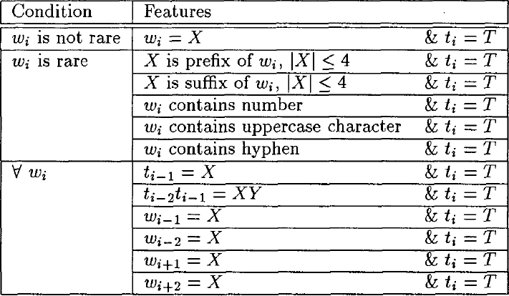
Example Features
POS Tagging
Week 4, Lecture 4

Slide 33
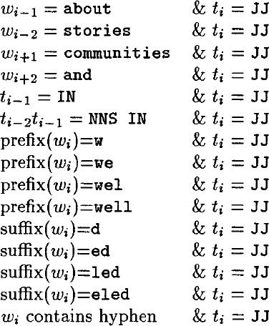
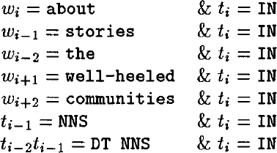
Example Features
POS Tagging
Week 4, Lecture 4
5 / 8

Slide 34
Search Algorithm
Conditional Probability
Given a sentence {w₁,..., w_{n}}, a tag sequence candidate {t₁, . . . , t_{n}} has conditional probability:
NPTEL
.
n
P(t , . . . , t |w . . . , w ) = p
(t |x )
1 n 1 n
i i
i=1
POS Tagging
Week 4, Lecture 4
6 / 8

Slide 35
Search Algorithm
Conditional Probability
Given a sentence {w₁,..., w_{n}}, a tag sequence candidate {t₁, . . . , t_{n}} has conditional probability:
.
n
P(t , . . . , t |w . . . , w ) = p
(t |x )
1 n 1 n
i i
i=1
A Tag Dictionary is used, which, for each known word, lists the tags that it has appeared with in the training set.
POS Tagging
Week 4, Lecture 4
6 / 8

Slide 36
Search Algorithm
Let W = {w₁,..., w_{n}} be a test sentence, s_{ij} be the jth highest probability tag
sequence up to and including word w_{i}. Search description
Generate tags for w₁, find top N, set s_{1j}, 1 ≤ j ≤ N, accordingly. Initialize i = 2
Initialize j = 1
Generate tags for w_{i}, given s_{(i−1)j} as previous tag context, and append each tag to s_{(i−1)j} to make a new sequence
j = j + 1, repeat if j ≤ N
Find N highest probability sequences generated by above loop, set s_{ij}
accordingly
i = i + 1, repeat if i ≤ n
Return highest probability sequence s_{n1}
POS Tagging
Week 4, Lecture 4
7 / 8

Slide 37
A Good Reference
Berger et al., A Maximum Entropy Approach to Natural Language Processing, Computational Linguistics, Vol. 22, No. 1.
POS Tagging
Week 4, Lecture 4
8 / 8

Slide 38
Conditional Random Fields
Pawan Goyal
CSE, IIT Kharagpur
Week 4, Lecture 5
POS Tagging
Week 4, Lecture 5
1 / 8

Slide 39
Practice Question
Suppose you want to use a MaxEnt tagger to tag the sentence, “the light book”. We know that the top 2 POS tags for the words the, light and book are {Det, Noun}, {Verb, Adj} and {Verb, Noun}, respectively. Assume that the MaxEnt model uses the following history hi (context) for a word wi:
hi = {wi, wi−1, wi+1, ti−1}
where wi−1 and wi+1 correspond to the previous and next words and ti−1 corresponds to the tag of the previous word. Accordingly, the following features are being used by the MaxEnt model:
f1: ti−1 = Det and ti = Adj f2: ti−1 = Noun and ti = Verb f3: ti−1 = Adj and ti = Noun f4: wi−1 = the and ti = Adj
f5: wi−1 = the&wi+1 = book and ti = Adj f6: wi−1 = light and ti = Noun
f7: wi+1 = light and ti = Det
f8: wi−1 = NULL and ti = Noun
Assume that each feature has a uniform weight of 1.0.
Use Beam search algorithm with a beam-size of 2 to identify the highest probability tag sequence for the sentence.
POS Tagging
Week 4, Lecture 5

Slide 40
Problem with Maximum Entropy Models
Per-state normalization
All the mass that arrives at a state must be distributed among the possible successor states
This gives a ‘label bias’ problem
Let’s see the intuition (on paper)
POS Tagging
Week 4, Lecture 5
3 / 8

Slide 41
Conditional Random Fields
CRFs are conditionally trained, undirected graphical models. Let’s look at the linear chain structure
POS Tagging
Week 4, Lecture 5

Slide 42
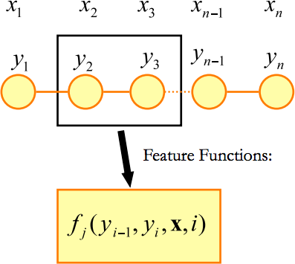
Conditional Random Fields: Feature Functions
POS Tagging
Week 4, Lecture 5

Slide 43
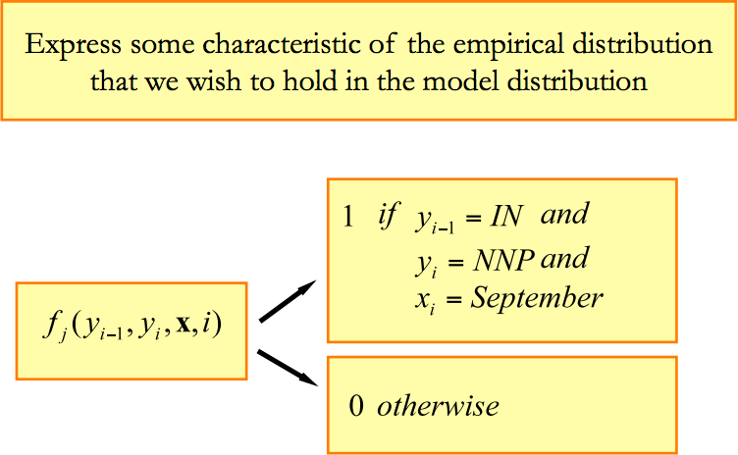
Feature Functions
POS Tagging
Week 4, Lecture 5

Slide 44
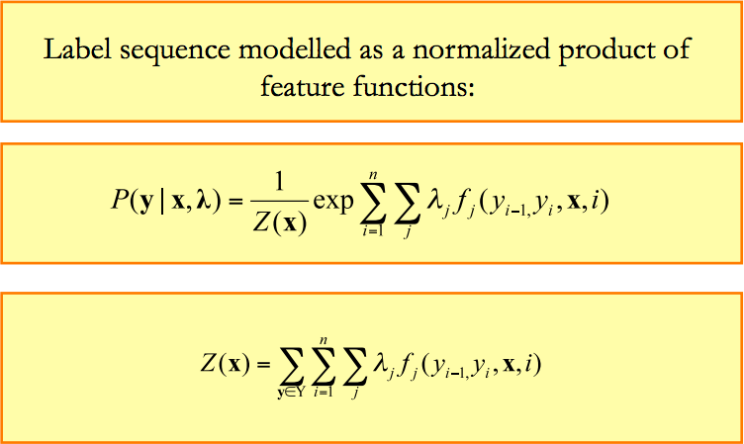
Conditional Random Fields: Distribution
POS Tagging
Week 4, Lecture 5

Slide 45
CRFs
Have the advantages of MEMM but avoid the label bias problem
CRFs are globally normalized, whereas MEMMs are locally normalized.
Widely used and applied. CRFs have been (close to) state-of-the-art in many sequence labeling tasks.
POS Tagging
Week 4, Lecture 5

